Slide 1
Fashion MNIST
Fashion MNIST
Apr 6, 2019
Team Members:
● Pratibha S ● Tarun Garg ● Zafar Chaudry

Slide 2
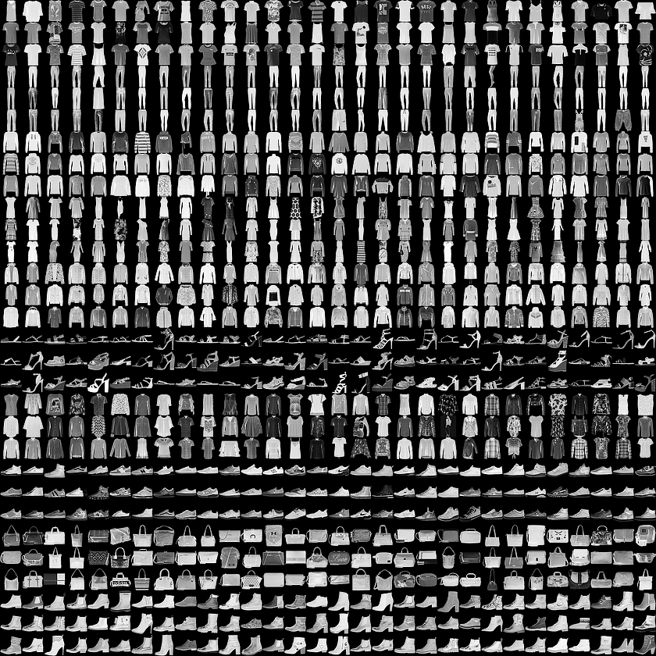
Overview
In fashion we often see a cloth or accessory and try to search that online. What we are trying to provide where a user can upload a pic and that tool will classify, extract features and search that online.
Dataset:https://www.kaggle.com/zalando-research/fashionmnist

Slide 3

Which algorithm will be the best fit?
Relu => Adam => Softmax
Relu => Dropout =>SGD

Slide 4

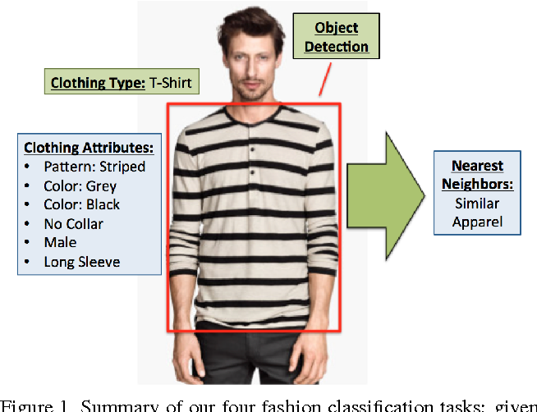
Its all about CLASSIFICATION !
Type | color | style
T-shirt/top | Red | Casual
Trouser | Blue | Office wear
Pullover | Pink | Sports wear

Slide 5
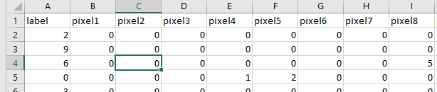
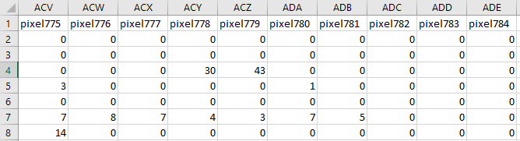
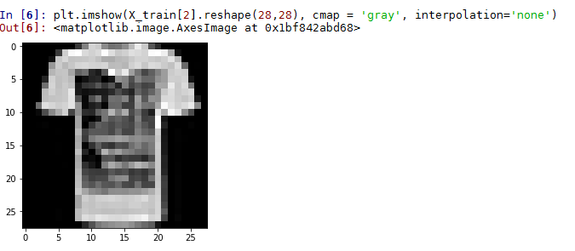
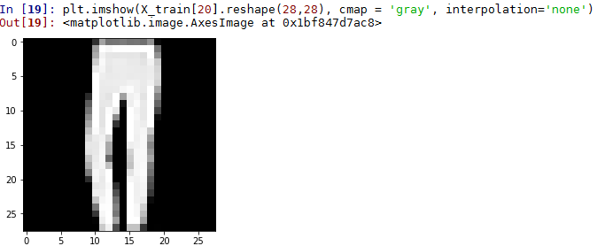
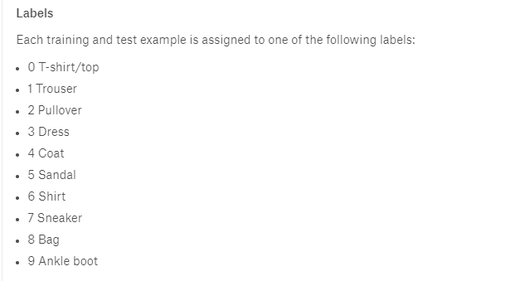
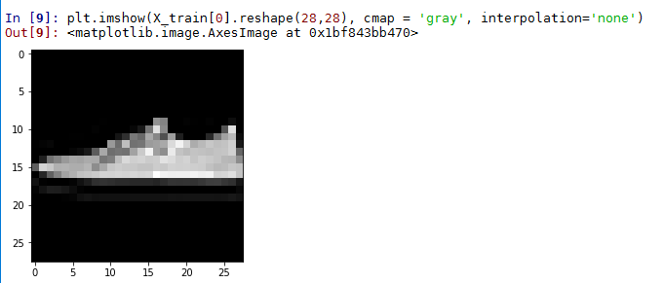
Quick Look at Dataset
…
Two csv files(training and test). Each has 784 columns(28x28 pixels)
60000 training and 10000 test entries.
Classified into 10 labels.

Slide 6
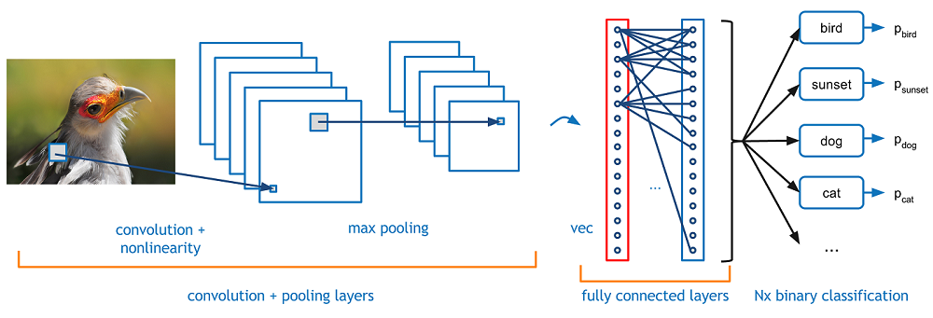
Models
Convolution Neural Networks (CNN)

Slide 7
Code and libraries used.
#### Data preprocessing ######
from keras.utils import to_categorical
import numpy as np
import pandas as pd
from sklearn.model_selection import train_test_split
import tensorflow as tf
data_train = pd.read_csv('C:\\Users\\zafarchaudry\\Documents\\deep_learning\\mnistfashion\\fashion-mnist_train.csv')
data_test = pd.read_csv('C:\\Users\\zafarchaudry\\Documents\\deep_learning\\mnistfashion\\fashion-mnist_test.csv')
img_rows, img_cols = 28, 28
input_shape = (img_rows, img_cols, 1)# This is for tensorflow. If it was for Theanos then 1 would appear in beginning. 1 means bw image.
X = np.array(data_train.iloc[:, 1:]) # This is creating list of lists for every row in data_train. First column is left out as its label.
y = to_categorical(np.array(data_train.iloc[:, 0]))# y is set equal to first column in data_train. It is set to categorical value with array of size 10.
#Here we split validation data to optimiza classifier during training
X_train, X_val, y_train, y_val = train_test_split(X, y, test_size=0.2, random_state=13)#Now X_train is 48000(rows) and X_val is 12000(rows). Same for y_train & y_val.
#Test data. data_test is split in same way as data_train.
X_test = np.array(data_test.iloc[:, 1:])
y_test = to_categorical(np.array(data_test.iloc[:, 0]))
X_train = X_train.reshape(X_train.shape[0], img_rows, img_cols, 1)# Here every row of 48k is further split into 28x28. So you have list of 48k with every element is list of 28 elements and there are total 28 such elements
X_test = X_test.reshape(X_test.shape[0], img_rows, img_cols, 1)
X_val = X_val.reshape(X_val.shape[0], img_rows, img_cols, 1)
X_train = X_train.astype('float32')
X_test = X_test.astype('float32')
X_val = X_val.astype('float32')
X_train /= 255 ### divide every element by 255 and store it back in same X_train.
X_test /= 255
X_val /= 255

Slide 8
Code and libraries used.
### Creating CNN model #####
import keras
from keras.models import Sequential
from keras.layers import Dense, Dropout, Flatten
from keras.layers import Conv2D, MaxPooling2D
from keras.layers.normalization import BatchNormalization
batch_size = 256
num_classes = 10
epochs = 50
#input image dimensions
img_rows, img_cols = 28, 28
model = Sequential() # initalize the neural network with sequence of layers.
model.add(Conv2D(32, kernel_size=(3, 3),
activation='relu',
kernel_initializer='he_normal',
input_shape=input_shape))
model.add(MaxPooling2D((2, 2))) ### maxpooling reduces data hence helping with overfitting.
model.add(Dropout(0.25)) #### dropout is simple way to avoid overfitting problem.
model.add(Conv2D(64, (3, 3), activation='relu')) # conv2d is for images. For videoes we will need 3d (because of time)
model.add(MaxPooling2D(pool_size=(2, 2)))
model.add(Dropout(0.25))
model.add(Conv2D(128, (3, 3), activation='relu'))
model.add(Dropout(0.4))
model.add(Flatten())
model.add(Dense(128, activation='relu')) # Dense is used to add fully connected layers.
model.add(Dropout(0.3))
model.add(Dense(num_classes, activation='softmax')) # here Dense is used to add the output layer. We use softmax for activation as problem is nonbinary.
model.compile(loss=keras.losses.categorical_crossentropy,
optimizer=keras.optimizers.Adam(),
metrics=['accuracy'])
model.summary()
history = model.fit(X_train, y_train, batch_size=batch_size, epochs=epochs, verbose=1,validation_data=(X_val, y_val))
score = model.evaluate(X_test, y_test, verbose=0)
## Predictions ###
from keras.preprocessing import image
test_image = X_test[299]
test_image = np.expand_dims(test_image, axis=0)
plt.imshow(test_image.reshape(28,28), cmap = 'viridis', interpolation='none')
model.predict_classes(test_image)

Slide 9
Models Accuracy
epochs = 50, activation function = ‘relu’, optimizer = adam, No. of conv layers = 3, No of max pooling = 2, feature detector size = 3x3, max pooling size = 2x2
Training accuracy = 0.9305, Validation accuracy = 0.9208
epochs = 50, activation function = ‘relu’, optimizer = SGD, No. of conv layers = 3, No of max pooling = 2, feature detector size = 3x3, max pooling size = 2x2
Training accuracy = 0.8105, Validation accuracy = 0.8439
epochs = 50, activation function = ‘tanh’, optimizer = adam, No. of conv layers = 3, No of max pooling = 2, feature detector size = 3x3, max pooling size = 2x2
Training accuracy = 0.9174, Validation accuracy = 0.9124
epochs = 50, activation function = ‘relu’, optimizer = adam, No. of conv layers = 3, No of max pooling = 2, feature detector size = 5x5, max pooling size = 2x2
Training accuracy = 0.930, Validation accuracy = 0.9209
Increase or decreasing batch size did NOT make significant difference.

Slide 10
Models Accuracy
Epochs | Activation Function | Optimizer | # Conv layer | # max pooling | Feature detection size | # max pooling size | Training Accuracy | Validation Accuracy
50 | Relu | Adam | 3 | 2 | 3x3 | 2x2 | 0.9305 | 0.9208
50 | Relu | SGD | 3 | 2 | 3x3 | 2x2 | 0.8105 | 0.8439
50 | Tanh | Adam | 3 | 2 | 3x3 | 2x2 | 0.9174 | 0.9124
50 | Relu | Adam | 3 | 2 | 5x5 | 2x2 | 0.930 | 0.9209
Increase or decreasing batch size did NOT make significant difference.

Slide 11
Inferences
Non Co- relation plots

Slide 12
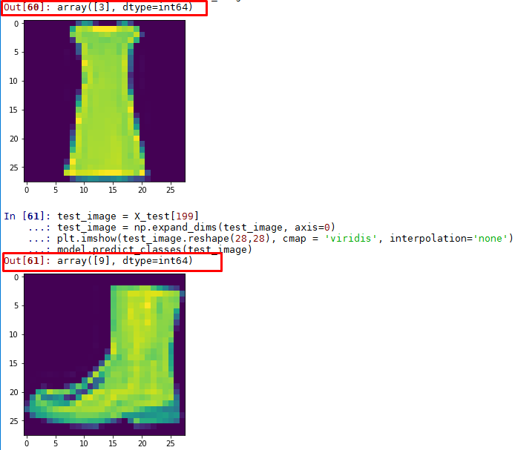
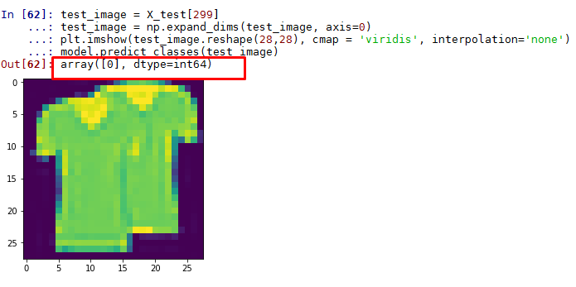
Result
Some predictions

Slide 13
Thank You!
Team Pic

